Slide 1
Developing a model to answer a public health question- a very brief example

Slide 2
Example question
In a population where TB is endemic, a new intervention involving screening and treating asymptomatic individuals is introduced. The treatment has 80% efficacy. What rate of screening would be required to reduce TB-related mortality by 50%?

Slide 3
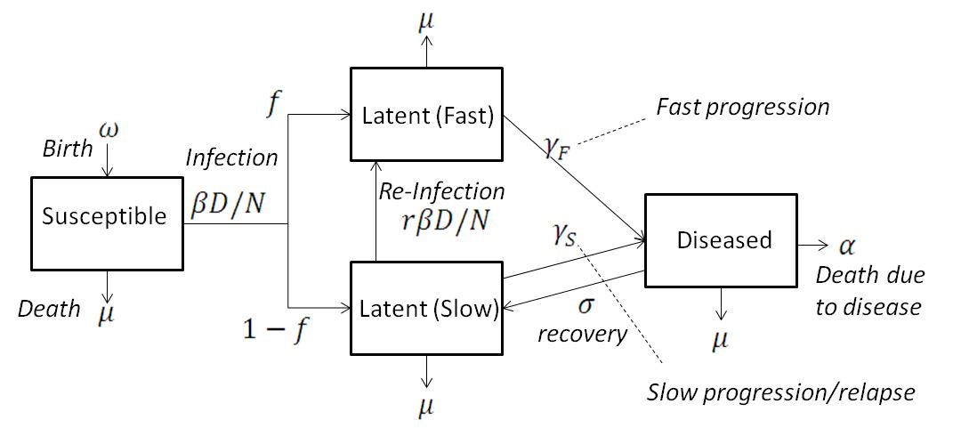
Dynamics of the disease
Luckily we already have a model of TB from practical 1
Proportion f of new infectives progress to disease at a much faster rate (0.5/year) than the remainder who progress very slowly (0.0001/year).
A proportion of re-infections r lead to slow progressing latents becoming fast progressing latents.

Slide 4
Example question
In a population where TB is endemic, a new intervention involving screening and treating asymptomatic individuals is introduced. The treatment has 80% efficacy. What rate of screening would be required to reduce TB-related mortality by 50%?

Slide 5
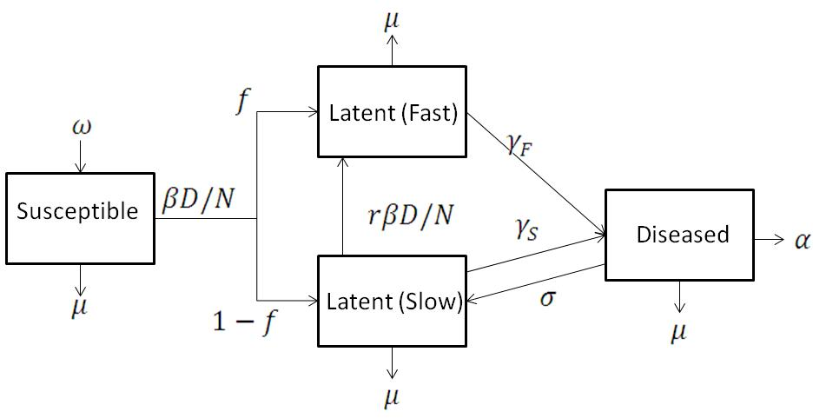
Implementing your chosen intervention
τ
τρ
τ
τ
τρ
τ
Define τ the annual rate (remember units!) at which people get screened within our population
Screen entire population but our intervention only changes dynamics by clearing infection from latently infected people.
Define ρ the probability of treatment working (from our question =0.8)
The rate at which latent individuals are cleared of infection is then τρ
What assumptions are we making?

Slide 6
Tracking assumptions
τρ
τρ
Diagnostic accuracy
Length and efficacy of treatment in each class
What happens when there is treatment failure?
Schedule of screening
What are we assuming about immunity?

Slide 7
Example question
In a population where TB is endemic, a new intervention involving screening and treating asymptomatic individuals is introduced. The treatment has 80% efficacy. What rate of screening would be required to reduce TB-related mortality by 50%?

Slide 8
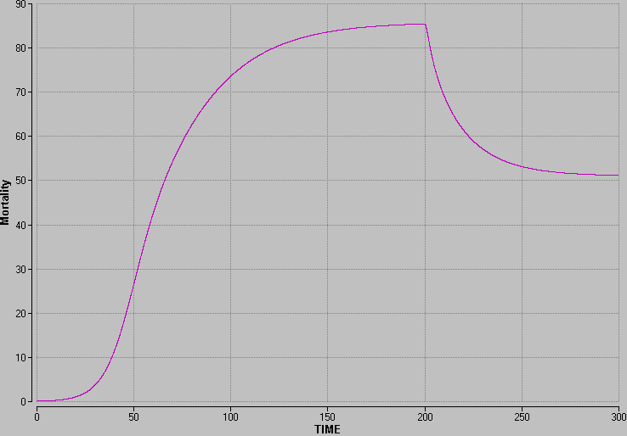
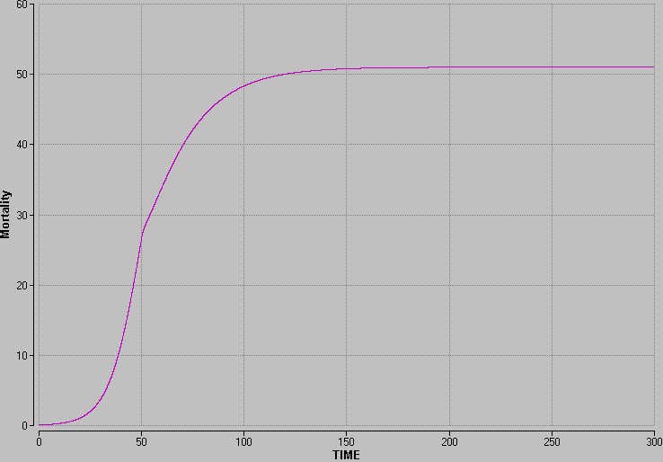


Apply your intervention in the correct context
Make sure you implement your intervention at the right stage of the epidemic to get the right result.
Effect at endemic equilibrium is likely to differ from early stages
Control the timing of your intervention with using an “if” statement
You may also want to include existing interventions

Slide 9
Example question
In a population where TB is endemic, a new intervention involving screening and treating asymptomatic individuals is introduced. The treatment has 80% efficacy. What rate of screening would be required to reduce TB-related mortality by 50%?

Slide 10
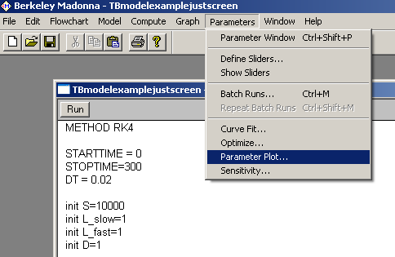
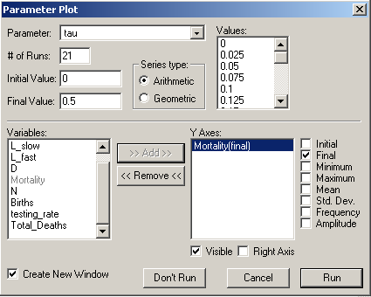
Using a parameter plot
Want to find the value of τ which will reduce mortality by 50%
One effective way to see how varying a parameter changes an outcome is to use a parameter plot
More complex parameter functions like optimise could also be useful

Slide 11
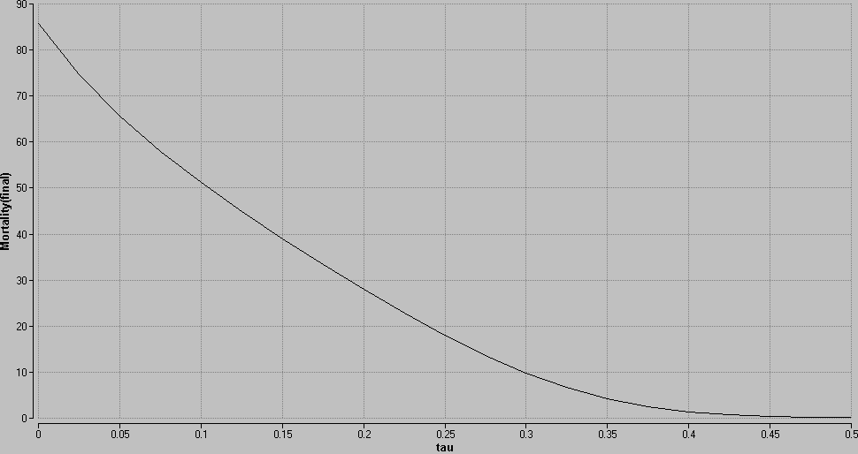
Arriving at your answer
Without screening endemic mortality rate of 85 deaths/year
Tau≈0.14 gives endemic mortality rate of 42.5 deaths/year
Answer is a screening rate of 0.14
In other words we need to screen people, on average, every 1/0.14=7.14 years
NOTE Not the same as screening 14% of the population per year

Slide 12
We have our answer what now?
Most important to appraise model critically and analytically- what could be wrong? How is this likely to affect conclusions?
Sensitivity Analyses
  What happens to your answer if you change one of the model parameters you’re unsure about?
  Can you find relationships between parameters? (e.g. what happens to our required screening rate if we reduce the efficacy of treatment?)
  Could any of your assumptions about the structure of your model change your conclusions?
Extend your model, suggestions in handout, in this example could:
  Look at required test specificity for a given level of resources
  Look at different screening strategies
  Heterogeneities such as age/immune status/access to healthcare

Slide 13
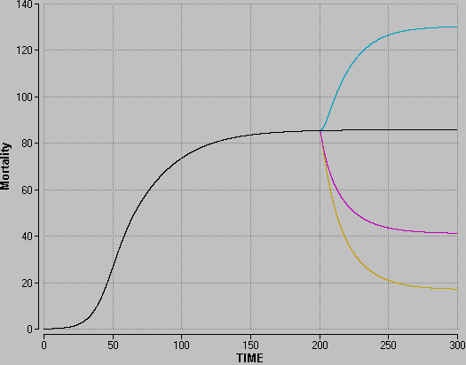
Effect of heterogeneity in treatment success
Treatment only effective in slow latents
No Screening
Effective in all latents
Only effective in fast latents
  Why is treating slow latents making the situation worse?

Slide 14
Looking at the impact of assumptions
τρ
Cleared (Fast)
τρ
βD/N
τρ
τρ
Cleared (Slow)
βD/N
  This is because according to our baseline parameter estimates r<f
  Why is this the case?
  Is this effect sensitive to other assumptions we’ve made about the structure of our model? (Immunity, heterogeneity)
  How might we change the model to look at the effects of these assumptions?

Slide 15
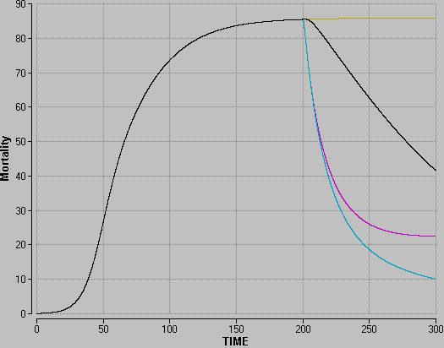
Effect of heterogeneity in treatment success (2)
No Screening
Treatment only effective in slow latents
Only effective in fast latents
Effective in all latents
  Clearly our model results are very sensitive to the assumptions we make about immunity/risk of infection following treatment.

Slide 16
Process of answering your question
Design your model – Finish by 9.30am Friday 24th November
Draw diagram of the natural dynamics of your chosen disease (may include existing interventions but doesn’t have to)
Incorporate your chosen intervention within your flow diagram
Obtain parameter estimates, specifying a range for at least one parameter to which you think your model may be particularly sensitive.
Programme your model
Implement your intervention at the correct stage of the epidemic
Be aware of assumptions you are making.
Make sure measuring outcome variable correctly (e.g. change in prevalence/incidence, impact on total no. of deaths)
Results and conclusions
Obtain an answer to your research question
Assess the sensitivity of your estimates to your chosen parameter
What assumptions have you made? Can you improve your model?

